Slide 1
Bellman Ford Algorithm

Slide 2
Can we apply Dijkstra to any weighted graph?

Slide 3
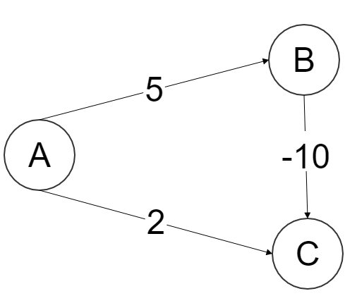
Can we apply Dijkstra to any weighted graph?

Slide 4
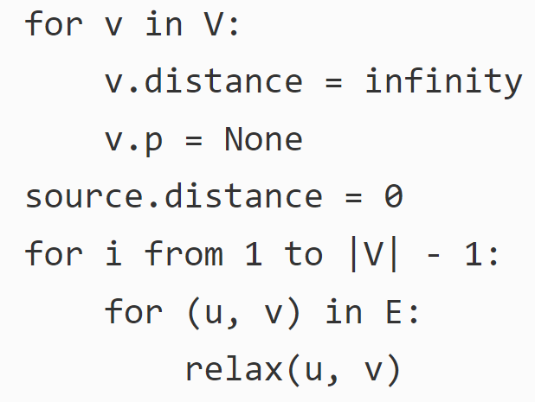
Bellman Ford Algorithm

Slide 5
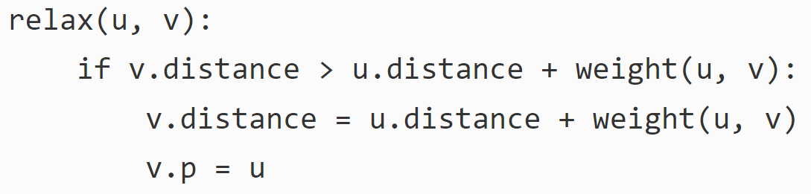
Bellman Ford Algorithm

Slide 6
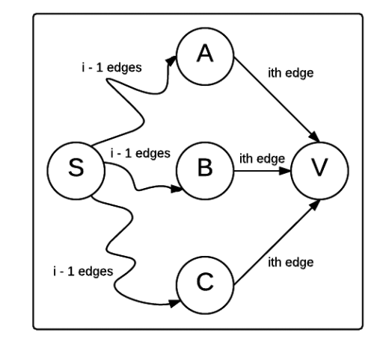
Bellman Ford Algorithm

Slide 7
Does bellman ford work on any graph?

Slide 8
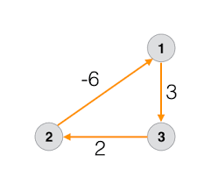
Does bellman ford work on any graph?

Slide 9
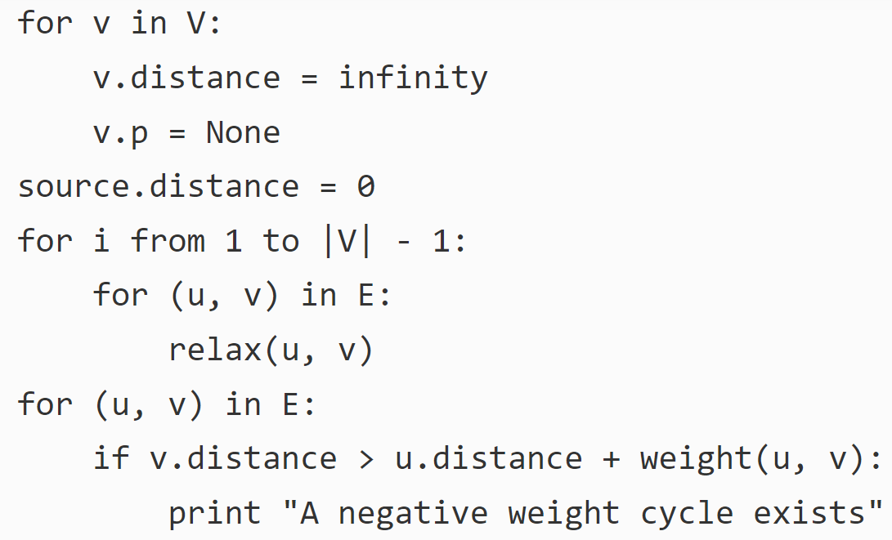
Detecting Negative Cycle

Slide 10
Floyd-Warshall Algorithm

Slide 11
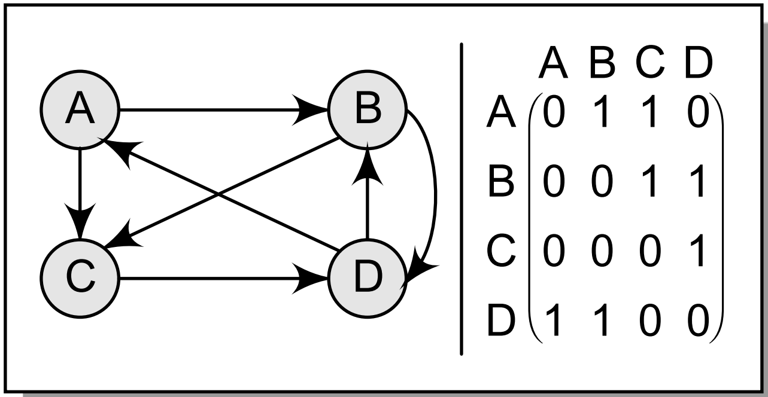
Path Matrix

Slide 12
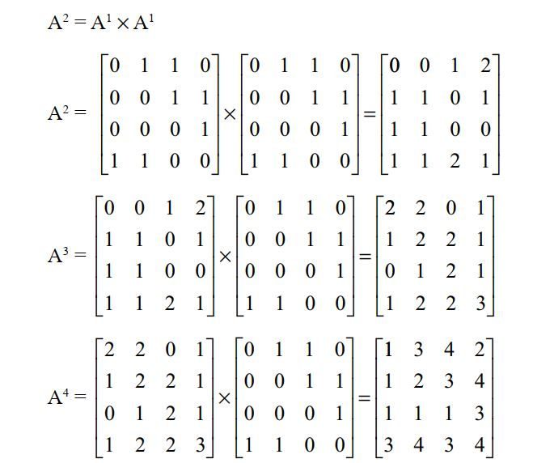
Path Matrix
Page: 389 (Data structure using C)

Slide 13
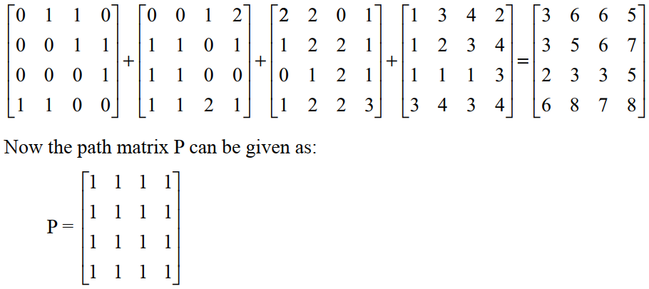
Path Matrix

Slide 14

Warshall’s Algorithm

Slide 15
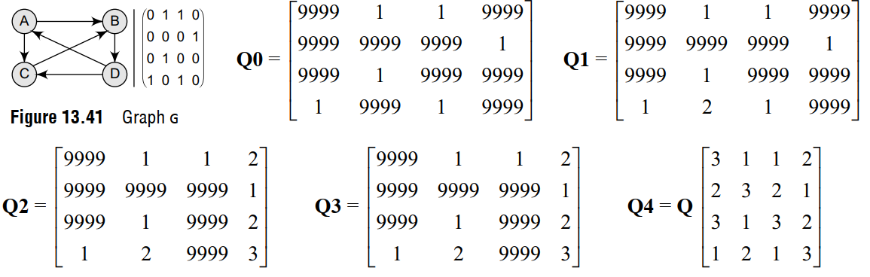
Floyd-Warshall Algorithm

Slide 16
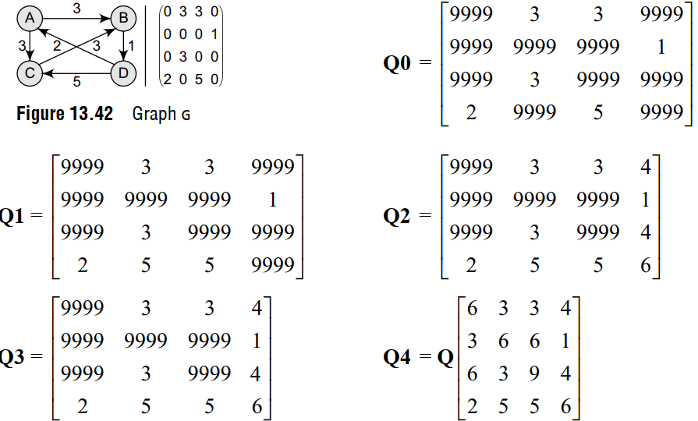
Floyd-Warshall Algorithm

Slide 17
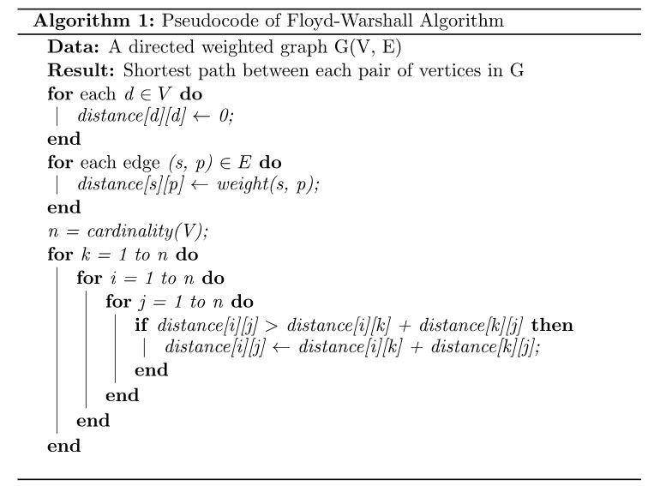
Floyd-Warshall Algorithm

